Slide 1


Forest Fire Detection & Prediction System
St. Francis Institute of Technology
Information Technology
IoE Mini Project (ITL802)
Prithvi Shetty | 13
Shitaanshu Singh | 14
Nishit Thakkar | 15
Nelkin Eldho | 16
Mentor:- Dr. Prachi Raut

Slide 2
Overview
Introduction
Literature Review
Problem Statement
System Design and Requirement
Data Analytics Algorithm
Results
Conclusion and Future Scope
References

Slide 3
Introduction
Millions of hectares of forest are destroyed by fire every year. Areas destroyed by these fires are large and produce more carbon monoxide than the overall automobile traffic [1].
Monitoring of the potential risk areas and an early detection of fire can significantly shorten the reaction time and also reduce the potential damage as well as the cost of fire fighting.

Slide 4
Literature Review
Ref no. | Title of Paper | Review | Limitations
[2] | IoT based forest fire prediction and detection. | In this paper they have used tmp sensor to collect temperature. Collected data is analyzed by KNN algorithm and is compared with real time forest fire occurrence data. | Tmp36 temperature sensor has the least accuracy rate compared to its alternatives.

Slide 5
Literature Review
Ref no. | Title of Paper | Review | Limitations
[3] | IoT based forest fire warning system. | In this paper they have used nodemcu and the sensor used is lm35 sensor. When the sensor detects fire it will send notification via app and notifies the end user that forest fire is detected. | No early prediction of fire or smoke.

Slide 6
Literature Review
Ref no. | Title of Paper | Review | Limitations
[4] | Forest Fire Monitoring System Based On ZIGBEE Wireless Sensor Network. | A node system is used where a node contains two sensor and Ethernet connecting to a ZigBee connection. As soon as fire and smoke are detected it is transmitted to the nearest node and a message is sent to the cloud. | This system is expensive to implement and no early prediction of fire is implemented using prediction models.

Slide 7
Problem statement
To develop a forest fire detection and prediction system which would help in early detection according to the type of fire thus reducing the damage.

Slide 8
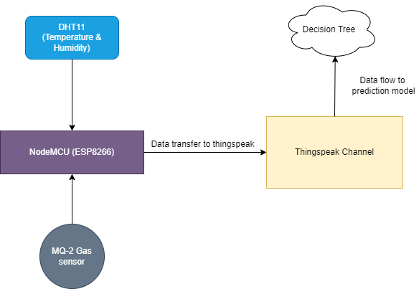
System Design

Slide 9
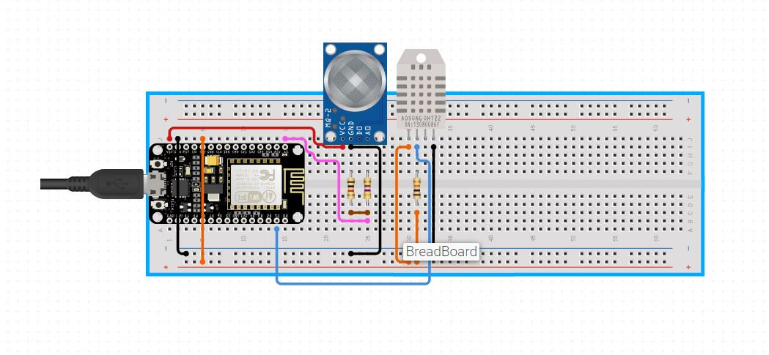
Circuit Diagram
MQ-2
DHT11
ESP 8266 (NodeMCU)

Slide 10
Requirements
Sr No. | NAME | QUANTITY | PRICE(Rs) | TOTAL
HARDWARE COMPONENTS
1 | NodeMCU esp8266 | 1 | 350 | 350
2 | DHT11 | 1 | 350 | 350
3 | Wires | 12 | 3 | 36
4 | Breadboard | 1 | 100 | 100
5 | MQ2 Smoke sensor | 1 | 120 | 120
 |  |  | TOTAL | 956
SOFTWARE
1 | WINDOWS 10 | 1 | - | -
2 | ARDUINO IDE | 1 | FREE
 |  |  | TOTAL | 956

Slide 11
Data Analytics Algorithm
Decision Tree Algorithm:
Decision Tree algorithm belongs to the family of supervised learning algorithms. Unlike other supervised learning algorithms, the decision tree algorithm can be used for solving regression and classification problems too.
The goal of using a Decision Tree is to create a training model that can use to predict the class or value of the target variable by learning simple decision rules inferred from prior data(training data).
In Decision Trees, for predicting a class label for a record we start from the root of the tree. We compare the values of the root attribute with the record’s attribute. On the basis of comparison, we follow the branch corresponding to that value and jump to the next node.
Input- Temperature and Humidity
Output- Occurrence of Fire
Data size- 100-200 observations

Slide 12
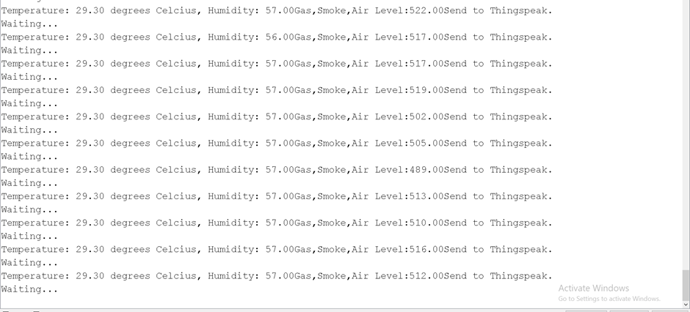
Results

Slide 13
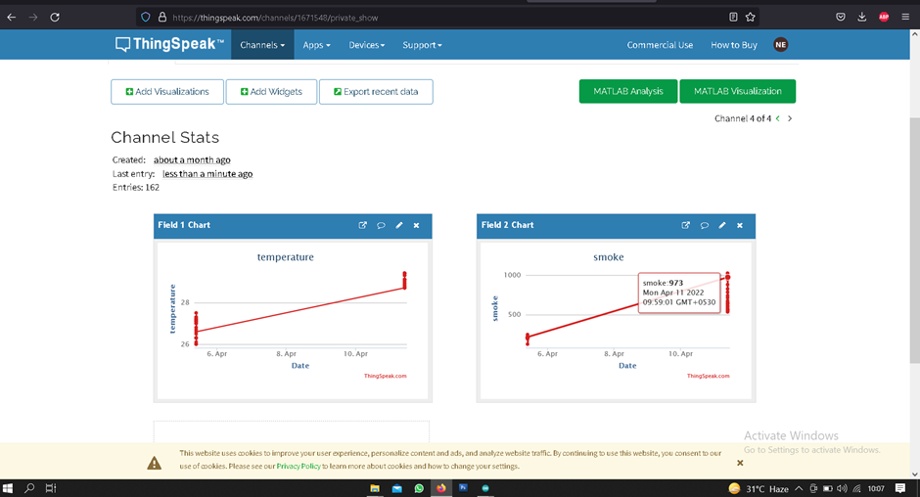
Results

Slide 14
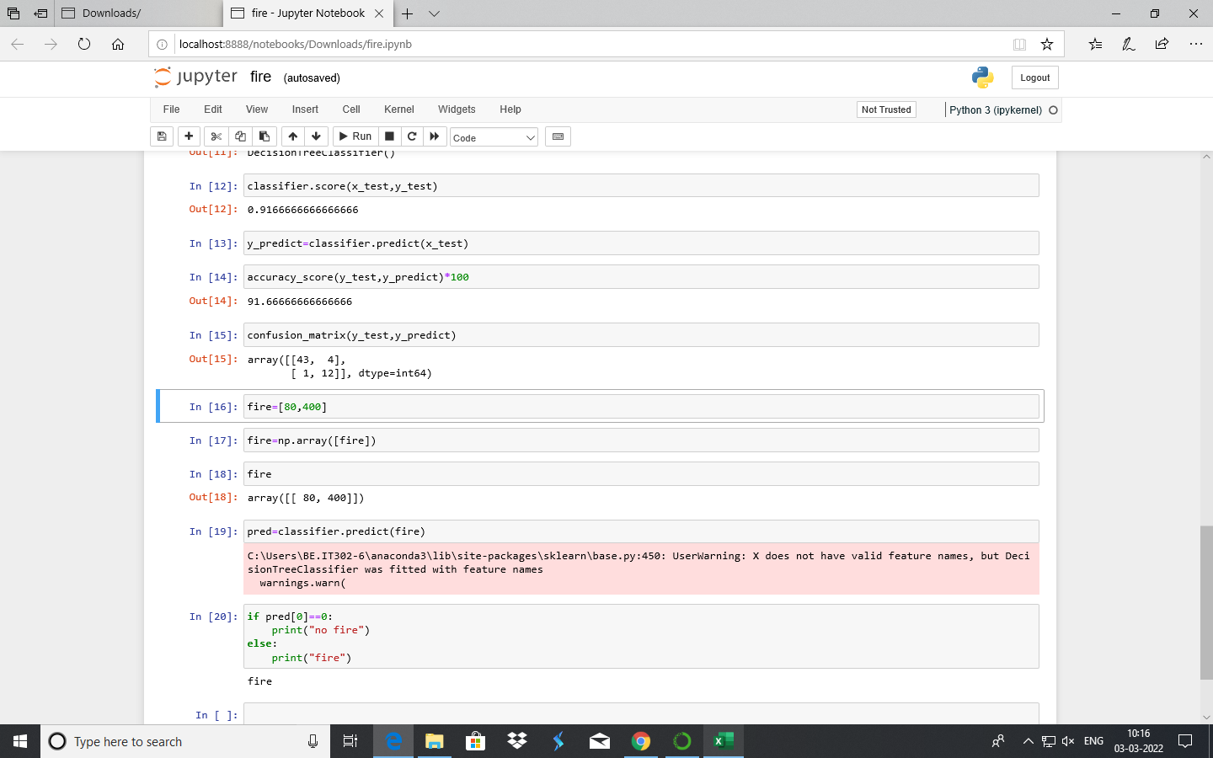
Results

Slide 15
Conclusion
The system will be helpful in predicting fire using data collected from fire and smoke sensors.
The early prediction & detection will lead to early precautionary measures to prevent the occurrence of fire and save the flora and fauna of wildlife.
The prediction model used in this system achieved 90% accuracy.

Slide 16
References
[1] https://en.wikipedia.org/wiki/Wildfire
[2] N. Saranya, S.Sahana, B.Suganthi, R.K. Vijaynigilesh,T.vivin, “Iot based forest fire prediction and detection”, April 2020-International Journal of Innovative technology and exploring engineering.
[3] Ragipati Karthik, M. Trinath Basu, J. Mahitha, V. Lokesh Reddy, “IoT established forest fire warning system”, March 2018 - International Journal of Engineering & Technology
[4] P.S. Jadhav , V.U. Deshmukh, “Forest Fire Monitoring System Based On Zig-bee Wireless Sensor Network”,International Journal of Emerging Technology and Advanced Engineering,(Volume 2, Issue 12, December 2012)

